Slide 1


DSCI 6003
MACHINE LEARNING
NAME OF PROJECT:
PRESENTED BY:
PRESENTED TO:
CodeCrack - Crack the Code, Train Your Brain
Kanyarasi
Dr. Mohamad Nassar

Slide 2









Our team
Ganesh
Akash
Varun
Anand
Naveen
Design Engineer
ML Developer
Data Engineer
Data Engineer
Data Analyst

Slide 3
Introduction
Welcome to CodeCrack!
In this project, we present CodeCrack—a smart, logic-based puzzle game integrated with machine learning. Designed to be played daily, it challenges players to crack a hidden code using strategy, deduction, and feedback.
This game not only entertains but also trains the mind, tracks user behavior, and adapts difficulty using a trained ML model. The entire development journey—from curiosity-driven questions to value creation through intelligent adaptation—follows the entrepreneurial mindset taught in DSCI 6003.

Slide 4

01
Game Engine: Python-based logic with support for human and AI play.
02
AI Solver: Simulates strategic guessing using elimination logic.
03
ML Model: Predicts difficulty level (easy, medium, hard) using Random Forest trained on time, guesses, and hints.
Overview
CodeCrack is a terminal-based, daily-play puzzle game inspired by Mastermind, where players guess a 4-digit code using logic and feedback. The game combines classic puzzle-solving with a modern machine learning approach to dynamically assess and adapt difficulty levels..
04
Data Collection: Automatically logs gameplay metrics to CSV files.
05
Value Creation: Personalized difficulty, smart hints, and engaging analytics make it valuable as a daily brain-training app.

Slide 5
Curiosity Questions
Clarify the project's main overall objectives and goals.
# 1
What features make puzzles more challenging?
# 2
How can guess feedback enhance player learning?
# 3
Can puzzle design adapt to individual skill levels?
# 4
How do code length and digit repetition affect difficulty?

Slide 6
Tools and Technologies
Software & Libraries Used:
Python: Core language for game, logic, and ML integration
Pandas: For reading, logging, and processing gameplay data
Matplotlib: Data visualization for analysis and reporting
Scikit-learn: Training Random Forest model for difficulty prediction
Joblib: Saving and loading trained models
CmapTools: Used for concept mapping of game components and entrepreneurial principles

Slide 7

Objectives and Goals
To create a logic-based daily-play mini-game that integrates machine learning to predict difficulty levels based on player performance and enhance user engagement through adaptive feedback.
Goal # 1
Goal # 2
Develop a playable terminal-based code-breaking game
Collect gameplay data to analyze player behavior
Goal # 3
Goal # 4
Train an ML model to classify puzzle difficulty as Easy, Medium, or Hard
Align with the Entrepreneurial Mindset: Curiosity, Connections, and Creating Value

Slide 8

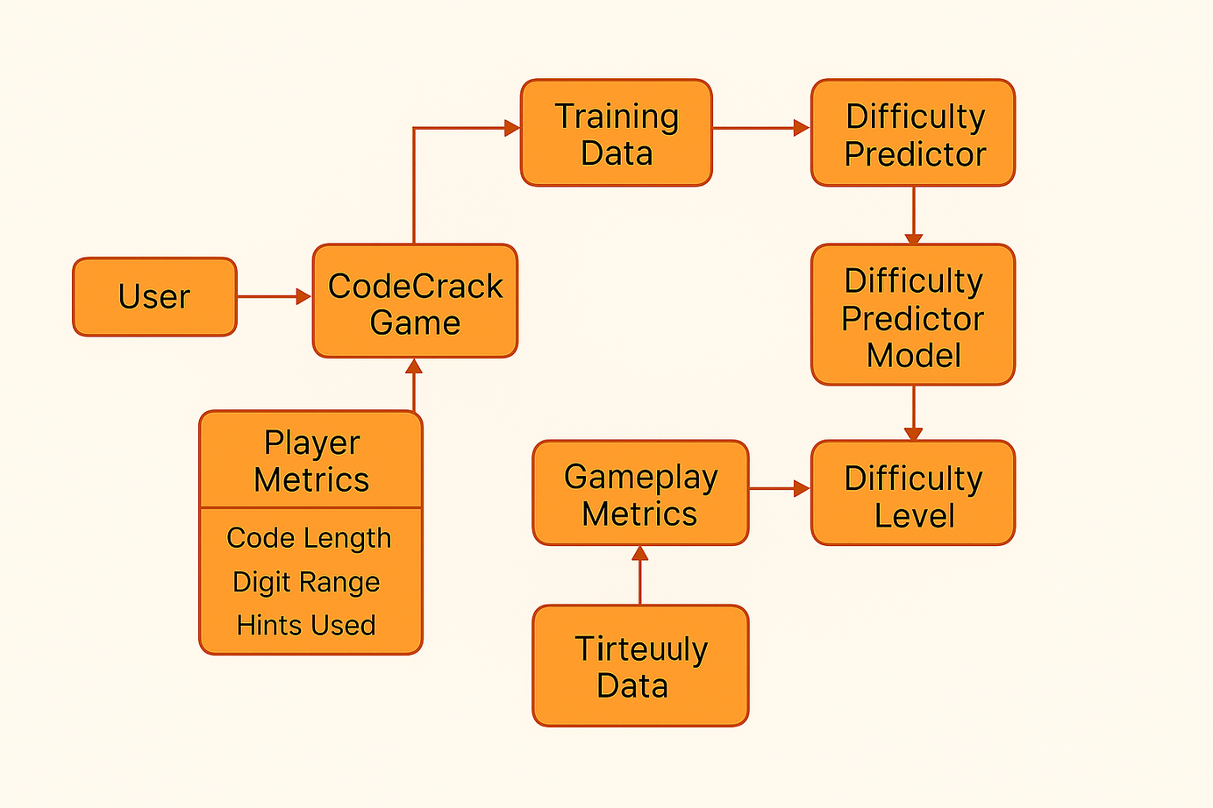
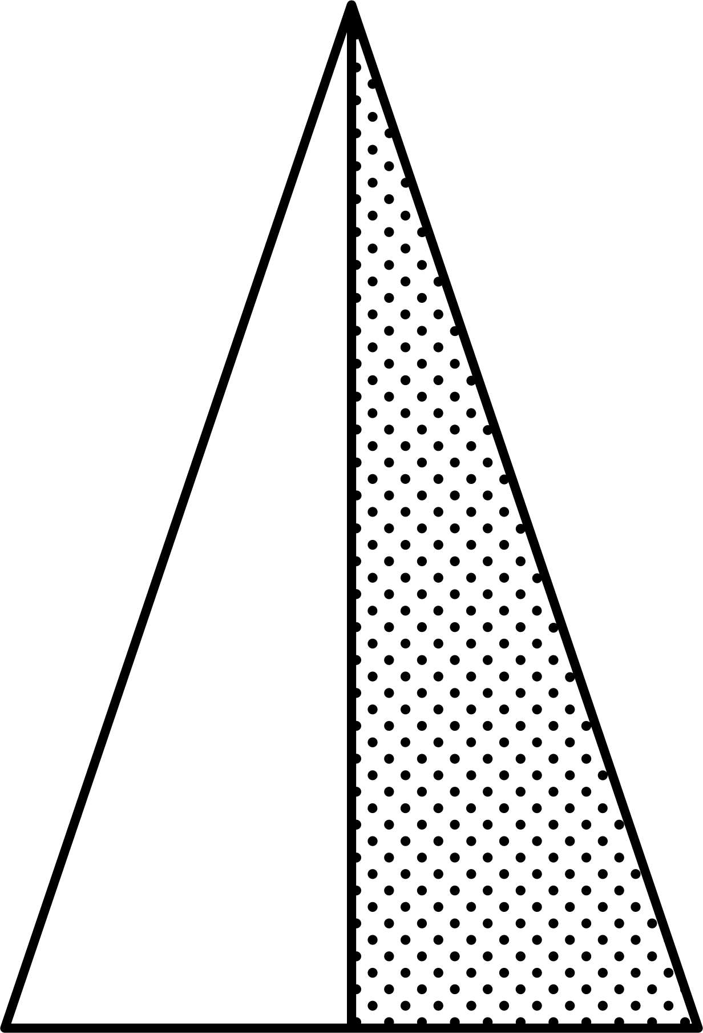
Data Flow
Entrepreneurial Mindset:
Connections Diagram showing relationships between:
Game mechanics
Machine learning model
Player metrics
Value creation
Core EM principles (Curiosity, Connections, Creating Value)
Tool used: Cmap or visual diagram (image provided)

Slide 9
Data Collection
How We Collected Gameplay Data:
Custom logging during each game session
Data stored to game_stats.csv and daily_scores.csv
Tracked Parameters:
Time taken to solve puzzles
Number of guesses used
Code settings (length, digit range, duplicates)
Hints used and game outcome (win/loss)
Outcome:
Dataset with over 500+ gameplay records for model training and insight generation

Slide 10
ML Model Overview
Objective: Predict puzzle difficulty using player performance data
Training Data: game_stats.csv
Features:
Time taken
Guesses used
Hints used
Code length
Duplicate setting
Model: RandomForestClassifier
Output Labels: easy, medium, hard
Script: train_difficulty_predictor.py Output: difficulty_predictor.pkl

Slide 11
what we are using…!!!
Objective: Tkinter Components Overview
Main Window:
tk.Tk() – Initializes the main application window.
Widgets for Layout and Interaction:
tk.Frame – Organizes and groups widgets.
tk.Label – Displays text or images.
tk.Button – Interactive buttons for user actions.
tk.Entry – Single-line text input fields.
ttk.Combobox – Dropdown selection menu (styled widget from ttk).
Image and Background Handling:
tk.Canvas – Displays and manages the background image and custom drawings.
PIL.Image & ImageTk.PhotoImage – Used to load, resize, and render images on the canvas.
Popup Windows:
tk.Toplevel() – Creates secondary windows (e.g., for "View My Stats").

Slide 12
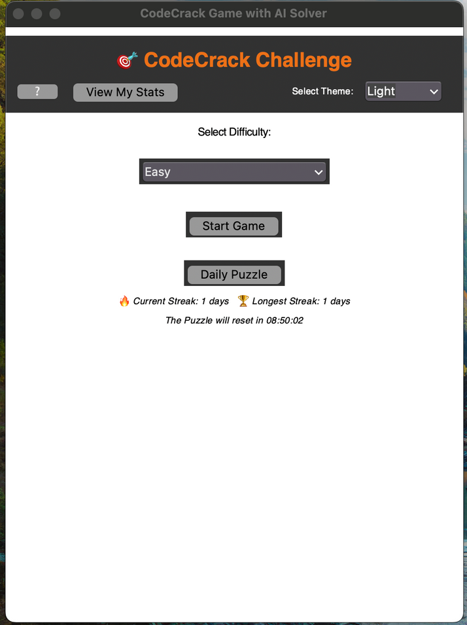
Game Play Demo & Human play
Demo Scripts:
play_game_human.py: Terminal game for players
ai_vs_code.py: AI auto-solver mode
Screenshot Examples:
Game feedback in terminal
ML model prediction during play
Hint generation logic
CodeCrack Game Rules:
• Your goal is to guess the hidden code.
• After each guess, you'll receive feedback:
✔️ = Correct digit in correct position
↔️ = Correct digit in wrong position
✖️ = Incorrect digit
• No duplicate digits (Easy), duplicates allowed (Medium/Hard).
• You have limited guesses — use them wisely!
• You can request hints using the AI hint button.
• Daily Puzzle resets every midnight.

Slide 13
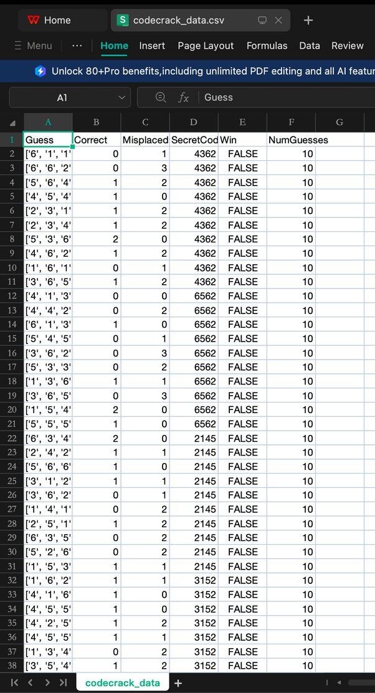
Data Storage
Gameplay Data Sources:
game_stats.csv:
Logs every game session
Includes time taken, guesses, code length, hints used, and win/loss outcome
Used for training the ML difficulty predictor
daily_scores.csv:
Tracks daily player performance and scores
Useful for monitoring player retention and performance trends
Data Quality Notes:
Over 500+ valid game records collected
Cleaned and preprocessed using Pandas
Enables both insight generation and model training

Slide 14
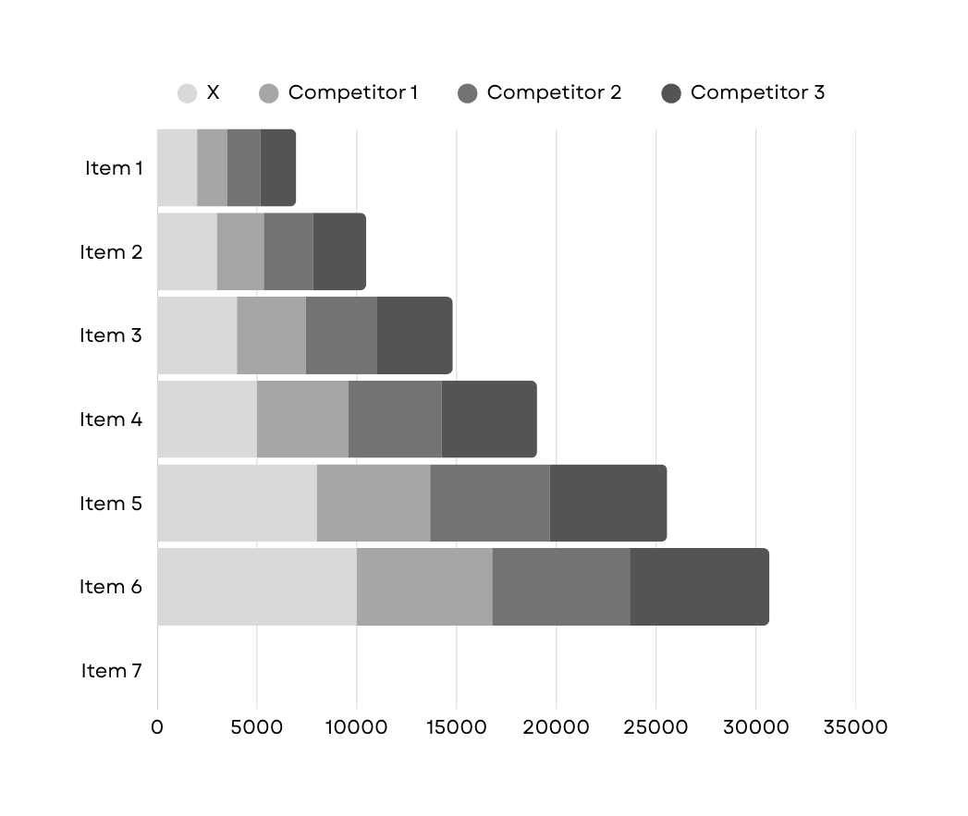
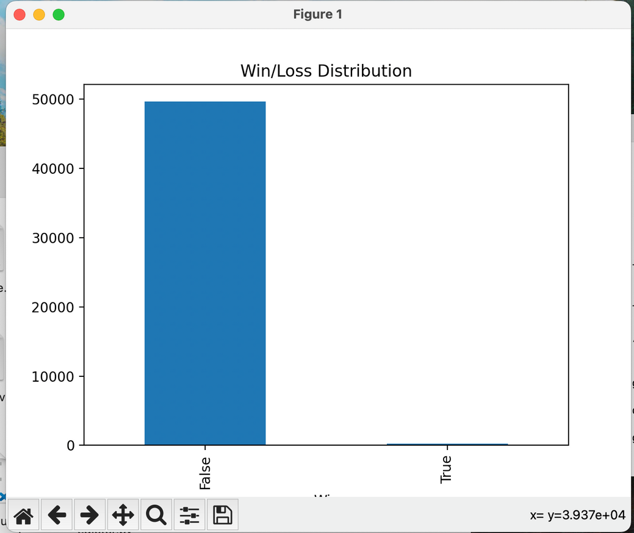
Data insights & visualization
Time vs. difficulty
Hint usage trends
Success/failure analysis
Script: game_data_visualizer.py
Visualizes trends from game_stats.csv
Supports ML tuning and UX improvement

Slide 15

Summary
WHY CODECRACK STANDS OUT:
Merges logical reasoning + machine learning
Real-time difficulty adaptation
Strong data pipeline for insights
Engaging daily use format

Slide 16

Resource & game inspiration
REFERENCE GAME: Wordle - The New York Times
Why Wordle?
Wordle is a highly engaging, daily-play word puzzle game
It emphasizes minimalism, logic, and feedback-based learning
The structure of guessing with limited tries and feedback inspired CodeCrack
CodeCrack vs Wordle:
CodeCrack uses numbers instead of words
Offers ML-powered hints and adaptive difficulty
Tracks detailed performance metrics for insight generation
Takeaway: Wordle helped shape the foundation of CodeCrack’s user interaction and feedback loop, while CodeCrack extended the concept with personalization and analytics.
https://www.nytimes.com/games/wordle/index.html

Slide 17
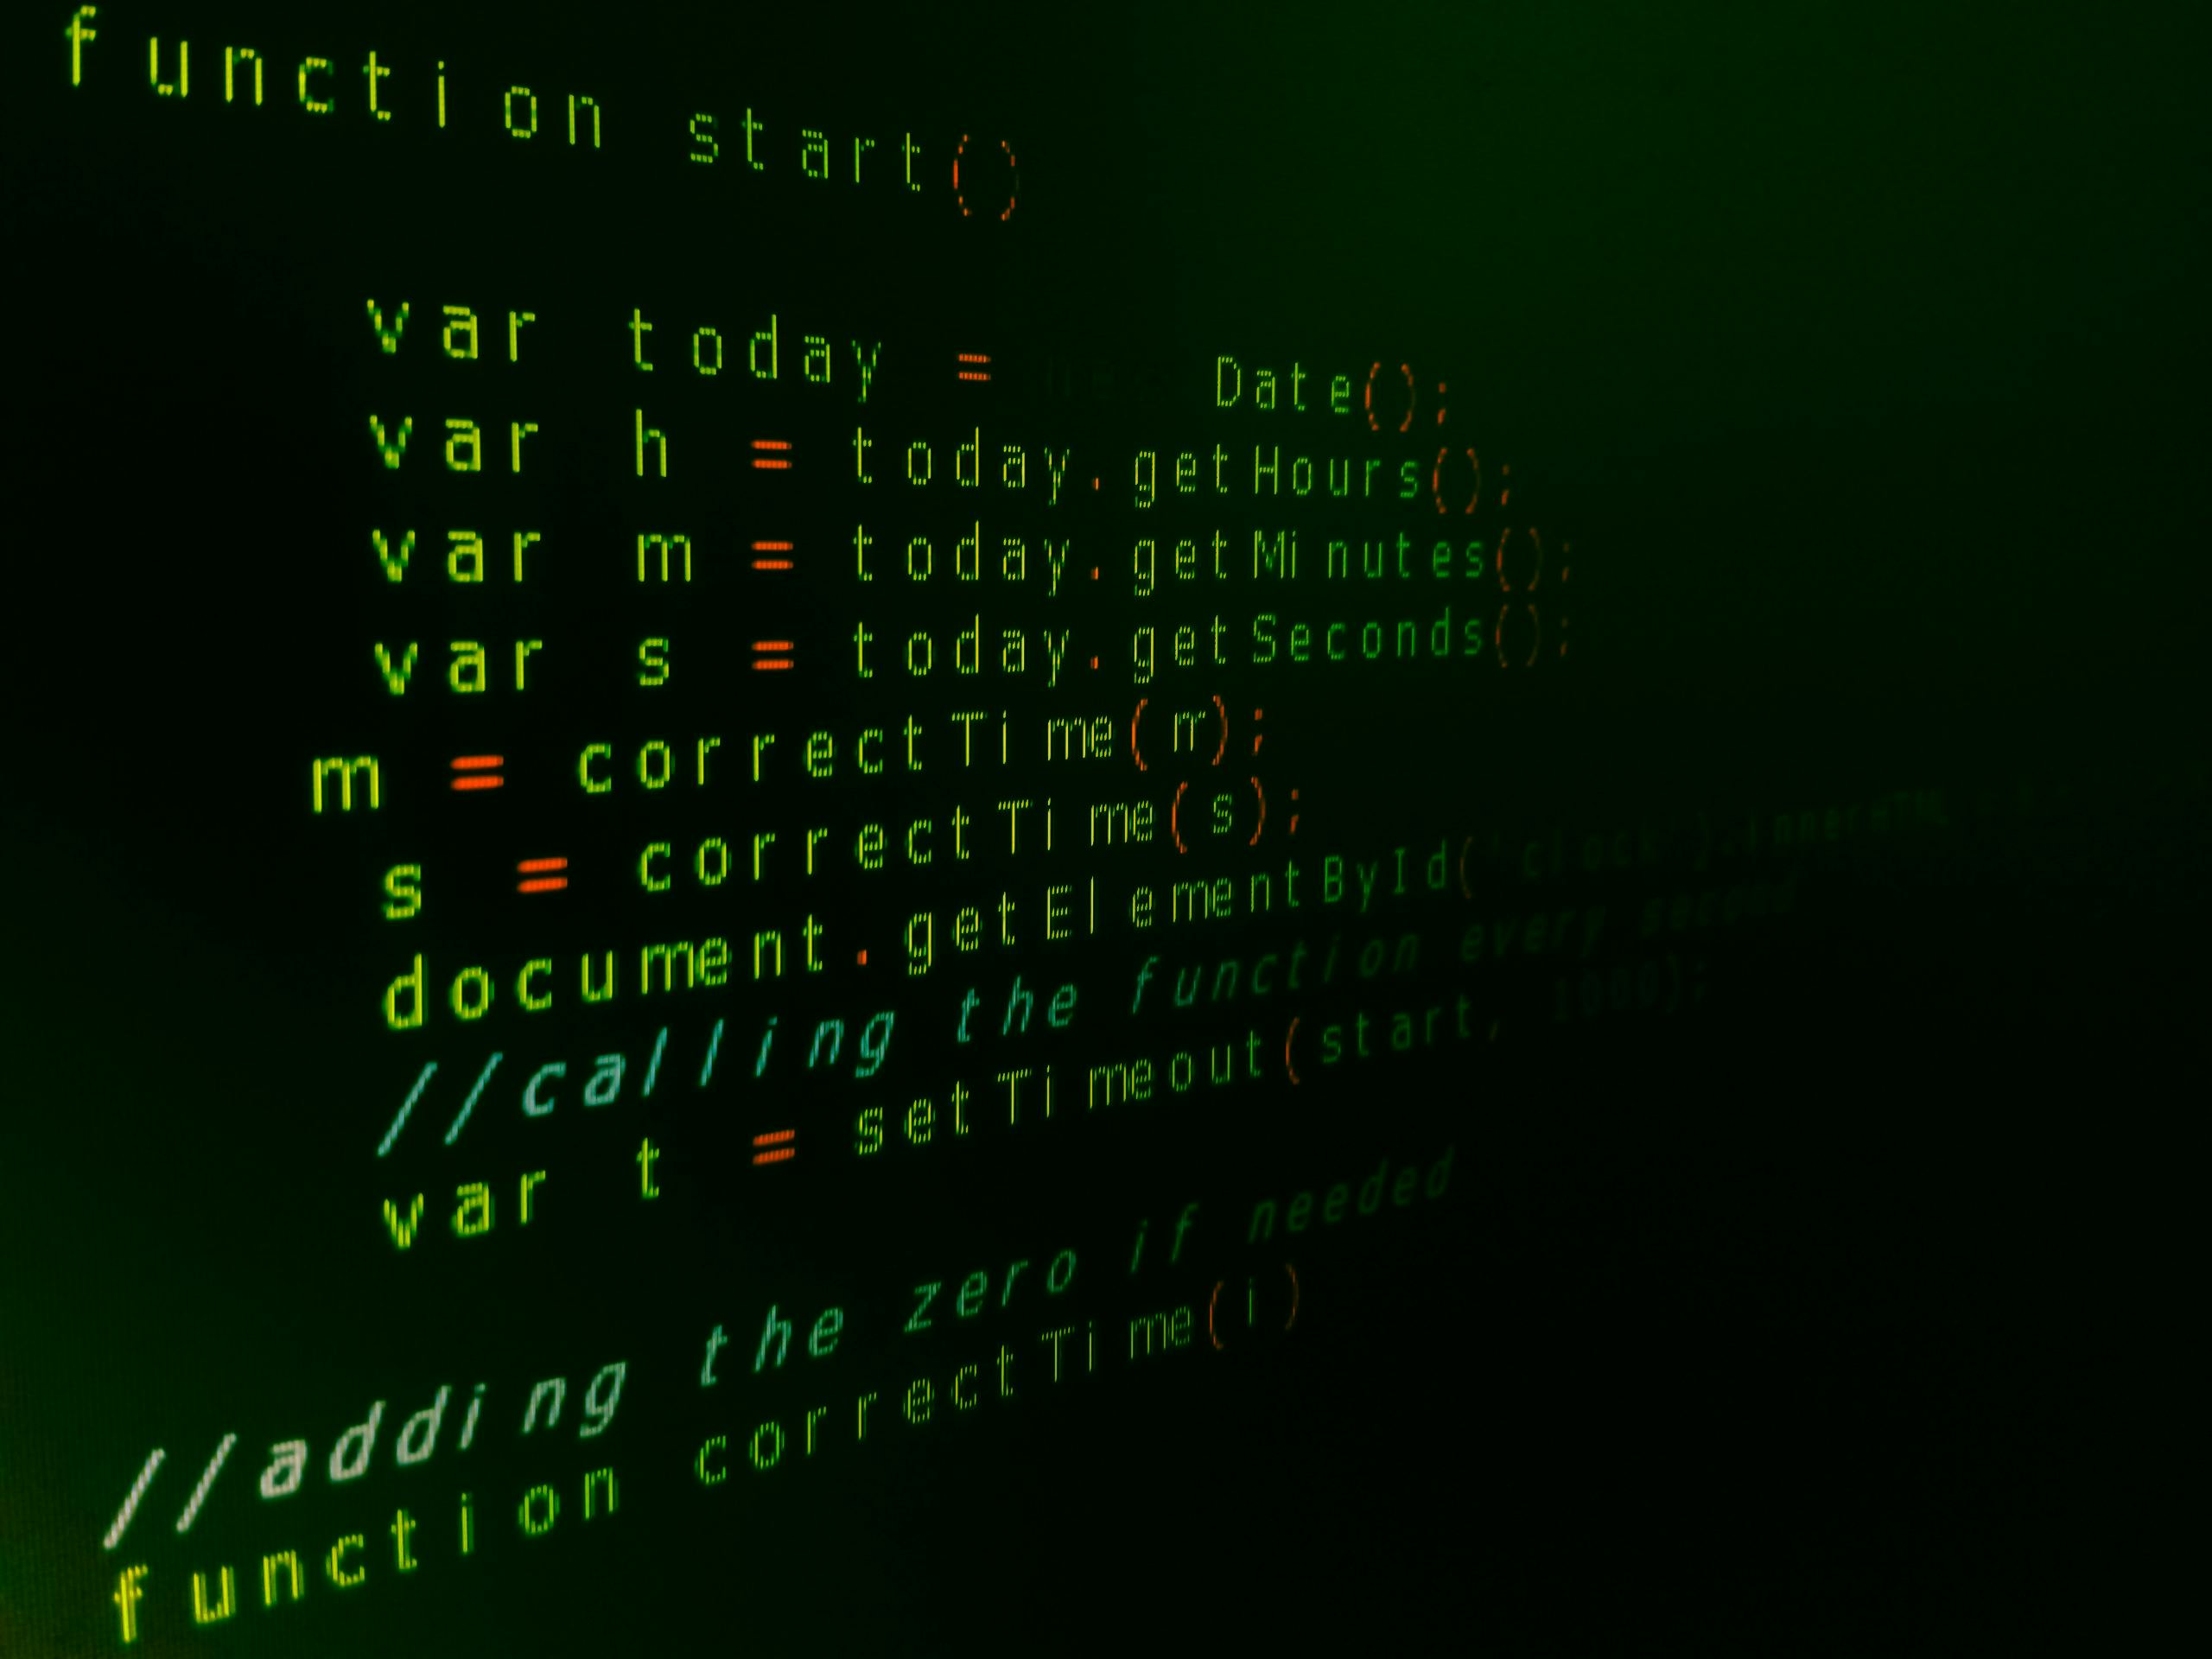
Code Execution

Slide 18
GitHub
https://github.com/AkashVemula99/ML-Project

Slide 19
Conclusion
CodeCrack was developed as a modern, ML-enhanced take on classic logic games, inspired by Wordle.
It successfully integrates gameplay, real-time feedback, and adaptive difficulty to enrich the user experience.
The project followed the entrepreneurial mindset through curiosity, connection of systems, and value creation.
The ML model enhances replayability and personalization, while data insights support continued improvement.
CodeCrack offers a compelling foundation for future features such as GUI, multiplayer, and web deployment. Why CodeCrack Stands Out:
Merges logical reasoning + machine learning
Real-time difficulty adaptation
Strong data pipeline for insights
Engaging daily use format

Slide 20
Thank you

